Slide 1


Content Category Analysis

Slide 2



Problem
Insights into Top Content Engagement

Slide 3
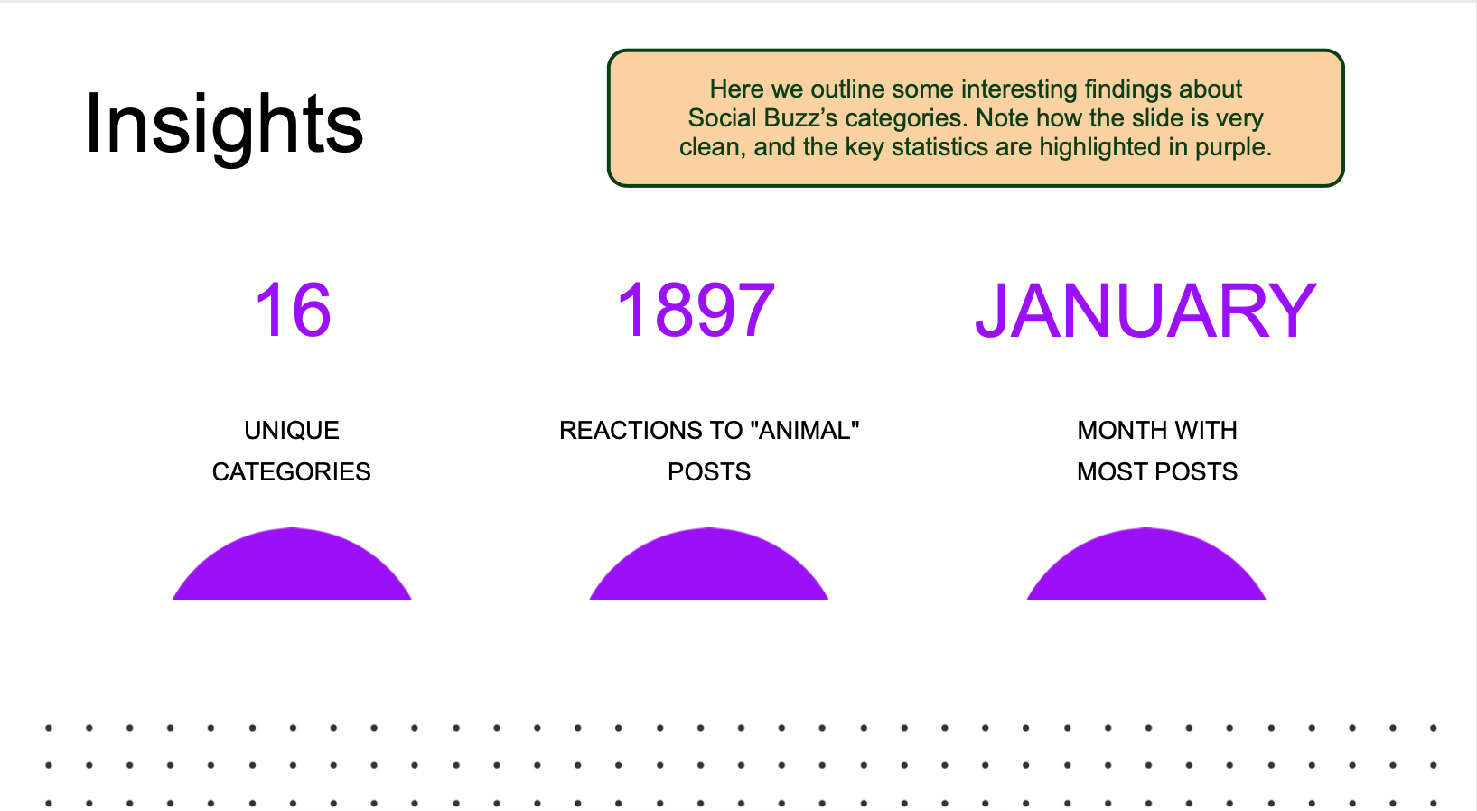


Insights

Slide 5
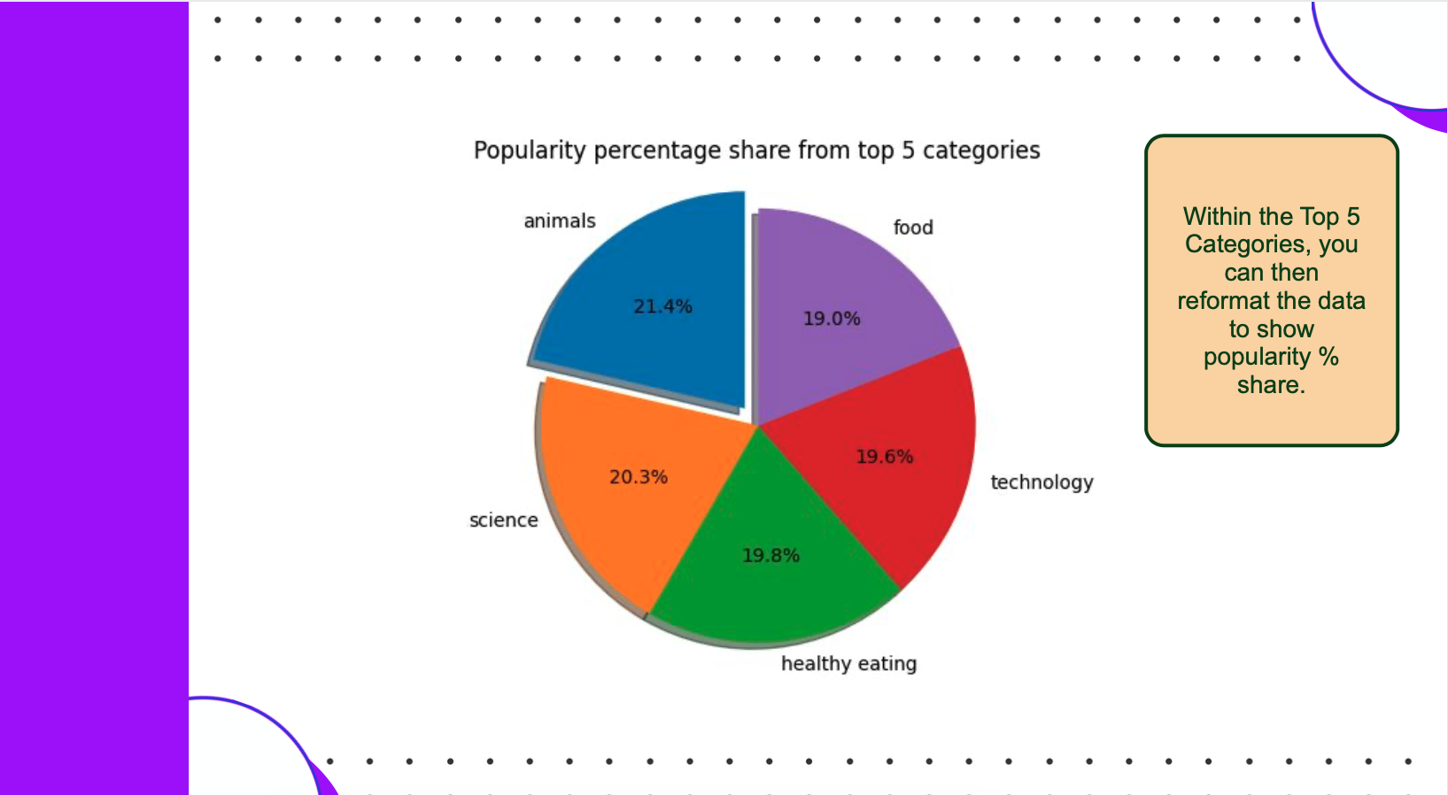

Slide 6

Analysis The "Animals" and "Science" categories are among the most popular, indicating a preference for content that is both factual and connected to real-life themes.
Insight Food-related topics, including "Healthy Eating," feature prominently in the top categories, suggesting an interest in lifestyle and well-being content. This insight could help guide the creation of campaigns, potentially in partnership with brands focused on health and wellness, to increase user engagement.
Next Steps This initial analysis provides valuable insights, but scaling this to a more continuous, real-time analysis could yield even more impact. Our team can support the development of a larger-scale, data-driven approach to continuously monitor and adapt content strategies based on real-time insights.
Summary

Slide 7

Thank you!
ANY QUESTIONS?

